Slide 1

Geometry
Unit 7, Lesson 7 The Unit Circle and Its Coordinates Volume 1, pg. 407

Slide 2


Benchmarks
MA.912.T.1.1
Define trigonometric ratios for acute angles in right triangles.
MA.912.T.1.2
Solve mathematical and real-world problems involving right triangles using trigonometric ratios and the Pythagorean Theorem.
volume 1, pg. 407

Slide 3
Integrated Mathematical Thinking and Reasoning Standards
MA.K12.MTR.1.1 Actively participate in effortful learning both individually and collectively.
MA.K12.MTR.4.1 Engage in discussions that reflect on the mathematical thinking of self and others.
MA.K12.MTR.5.1 Use patterns and structure to help understand and connect mathematical concepts.
volume 1, pg. 407

Slide 4


Learning Targets
I can explore relationships between the coordinates of vertices when the triangles are in different quadrants.
I can use side ratios of $45−45−90$ triangles to solve problems.
I can use side ratios of $30−60−90$ triangles to solve problems.
volume 1, pg. 407

Slide 5

Warm-Up
volume 1, pg. 408

Slide 6
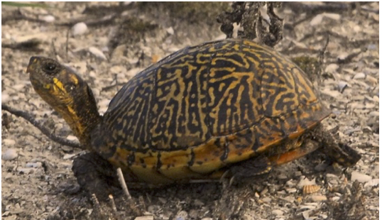
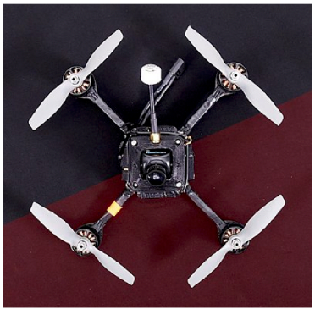
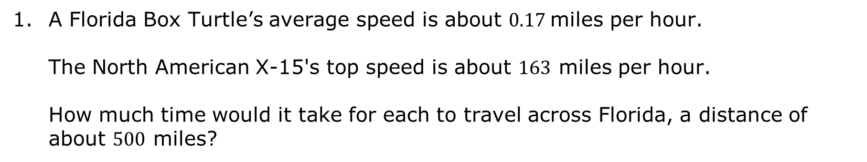
7.7.1 Warm-Up: Between Two Numbers
A Florida Box Turtle’s average speed is about $0.17$miles per hour. The North American X-15's top speed is about $163$ miles per hour. How much time would it take for each to travel across Florida, a distance of about $500$ miles?
volume 1, pg. 408

Slide 7

Exploration
volume 1, pg. 408

Slide 8

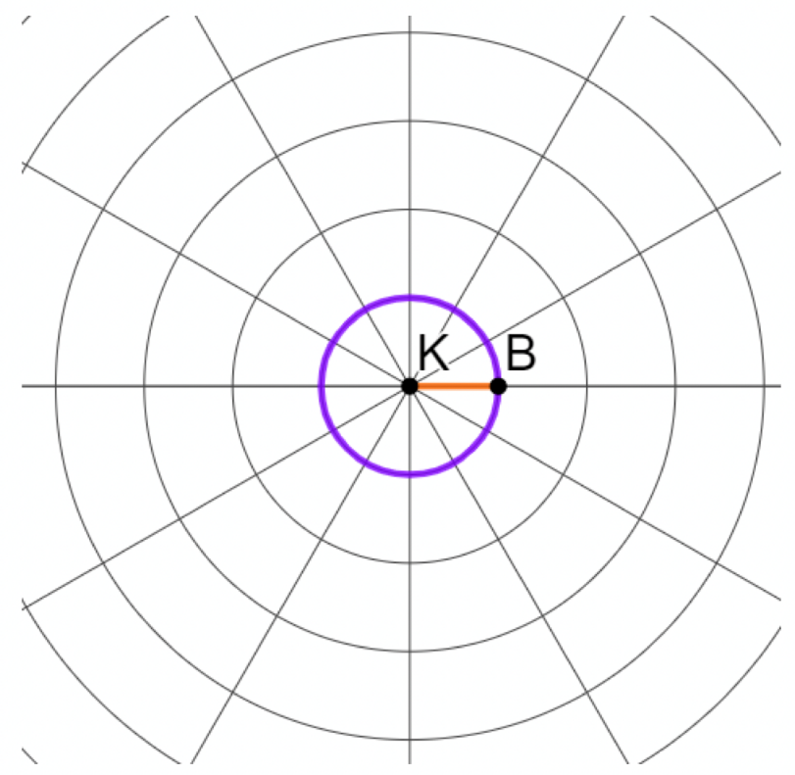
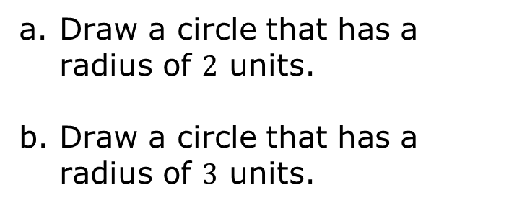
7.7.2 Exploration: The Unit Circle
Circle $K$ is shown on polar graph paper, where the length of $\overline{KB}$ is $1$ unit.
Draw a circle that has a radius of $2$ units.
Draw a circle that has a radius of $3$ units.
volume 1, pg. 408

Slide 9
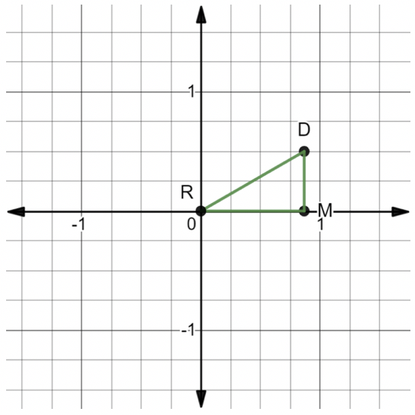
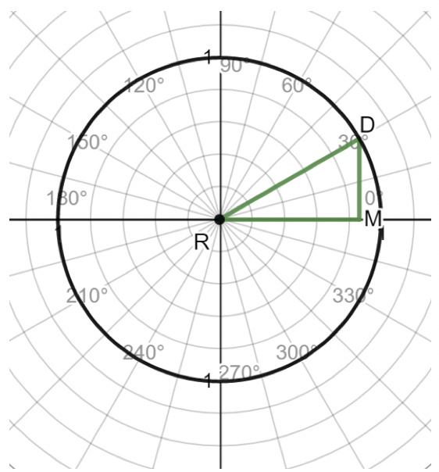
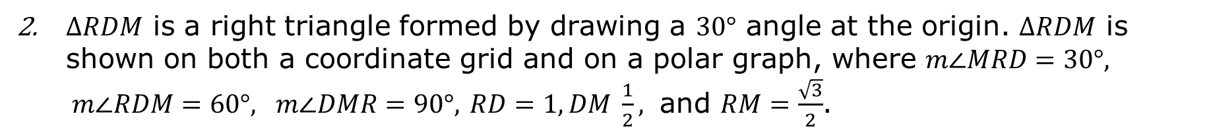
$∆RDM$ is a right triangle formed by drawing a $30°$ angle at the origin. $∆RDM$ is shown on both a coordinate grid and on a polar graph, where $m∠MRD=30°, m∠RDM=60°, m∠DMR=90°,$ $RD=1, DM \frac{1}{2},$ and $RM=\frac{\sqrt{3}}{2}$.
volume 1, pg. 409

Slide 10
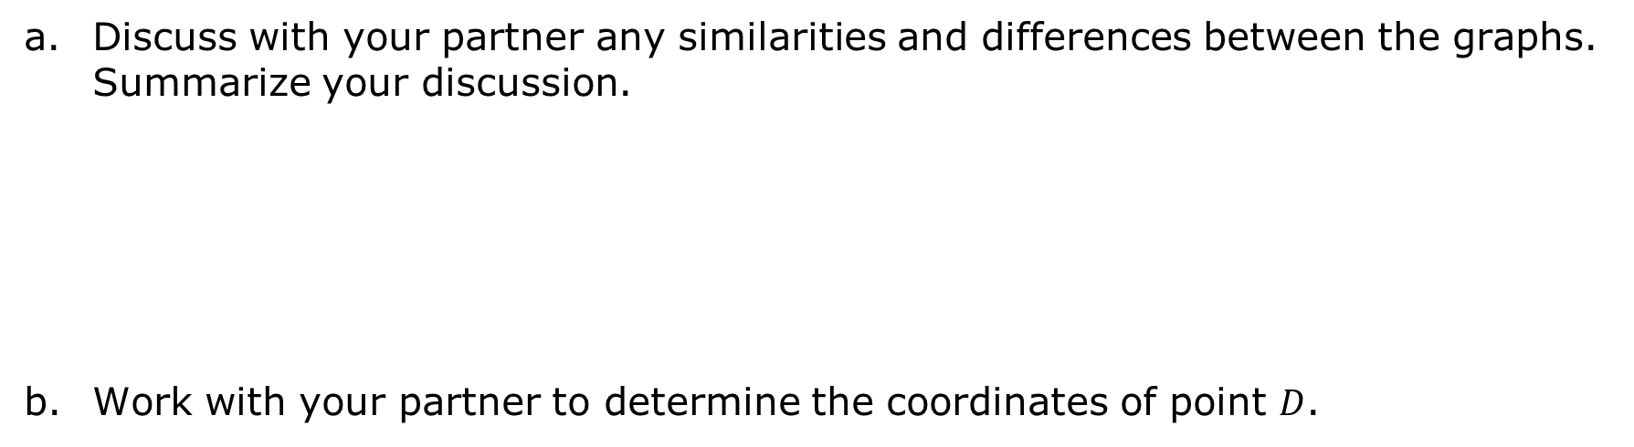
Discuss with your partner any similarities and differences between the graphs. Summarize your discussion.
Work with your partner to determine the coordinates of point $D$.
volume 1, pg. 409

Slide 11
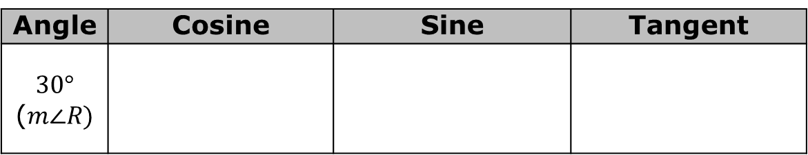
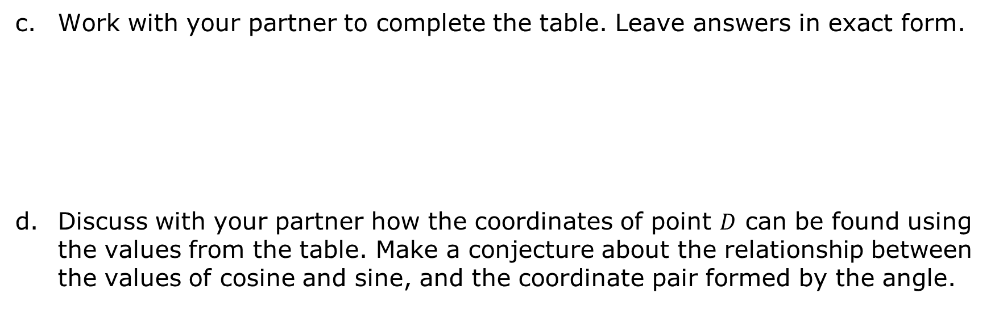
Work with your partner to complete the table. Leave answers in exact form.
Discuss with your partner how the coordinates of point $D$ can be found using the values from the table. Make a conjecture about the relationship between the values of cosine and sine, and the coordinate pair formed by the angle.
Angle | Cosine | Sine | Tangent
$$30°$$ ($m∠R)$
volume 1, pg. 409

Slide 12
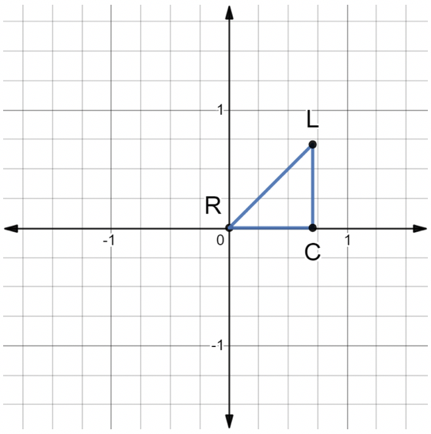
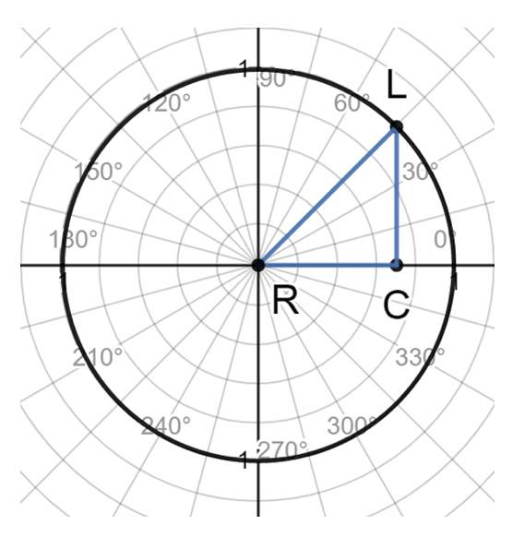
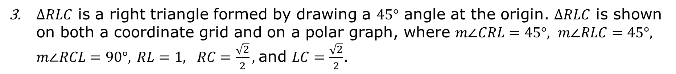
$∆RLC$ is a right triangle formed by drawing a $45°$ angle at the origin. $∆RLC$ is shown on both a coordinate grid and on a polar graph, where $m∠CRL=45°, m∠RLC=45°, m∠RCL=90°,$ $RL=1, RC=\frac{\sqrt{2}}{2},$and $LC=\frac{\sqrt{2}}{2}$.
volume 1, pg. 410

Slide 13
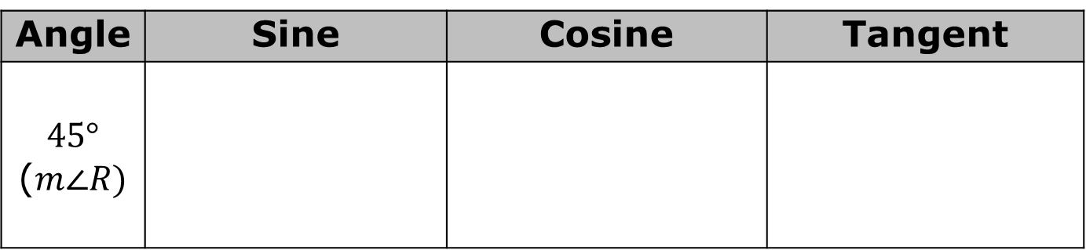
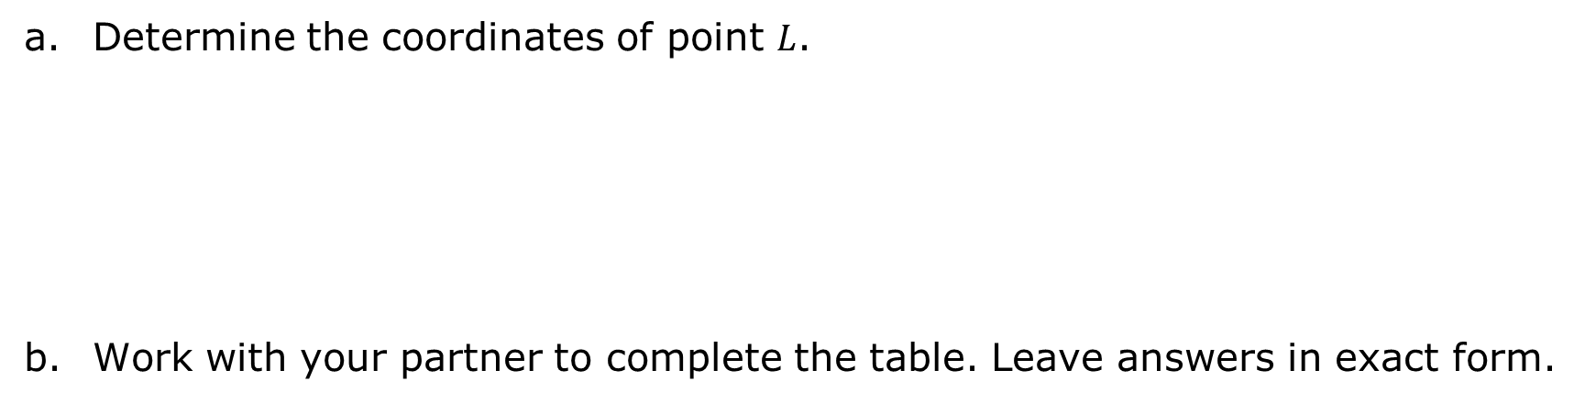
Determine the coordinates of point $L$.
Work with your partner to complete the table. Leave answers in exact form.
Angle | Sine | Cosine | Tangent
$$45°$$ ($m∠R)$
volume 1, pg. 410

Slide 14
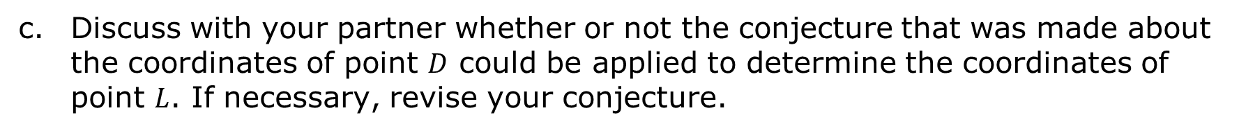
Discuss with your partner whether or not the conjecture that was made about the coordinates of point $D$ could be applied to determine the coordinates of point $L$. If necessary, revise your conjecture.
volume 1, pg. 410

Slide 15
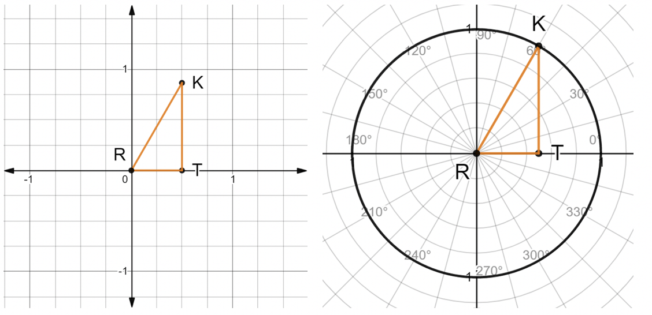
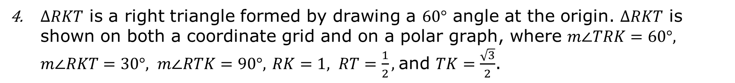
$∆RKT$ is a right triangle formed by drawing a $60°$ angle at the origin. $∆RKT$ is shown on both a coordinate grid and on a polar graph, where $m∠TRK=60°, m∠RKT=30°, m∠RTK=90°,$ $RK=1, RT=\frac{1}{2},$and $TK=\frac{\sqrt{3}}{2}$.
volume 1, pg. 411

Slide 16

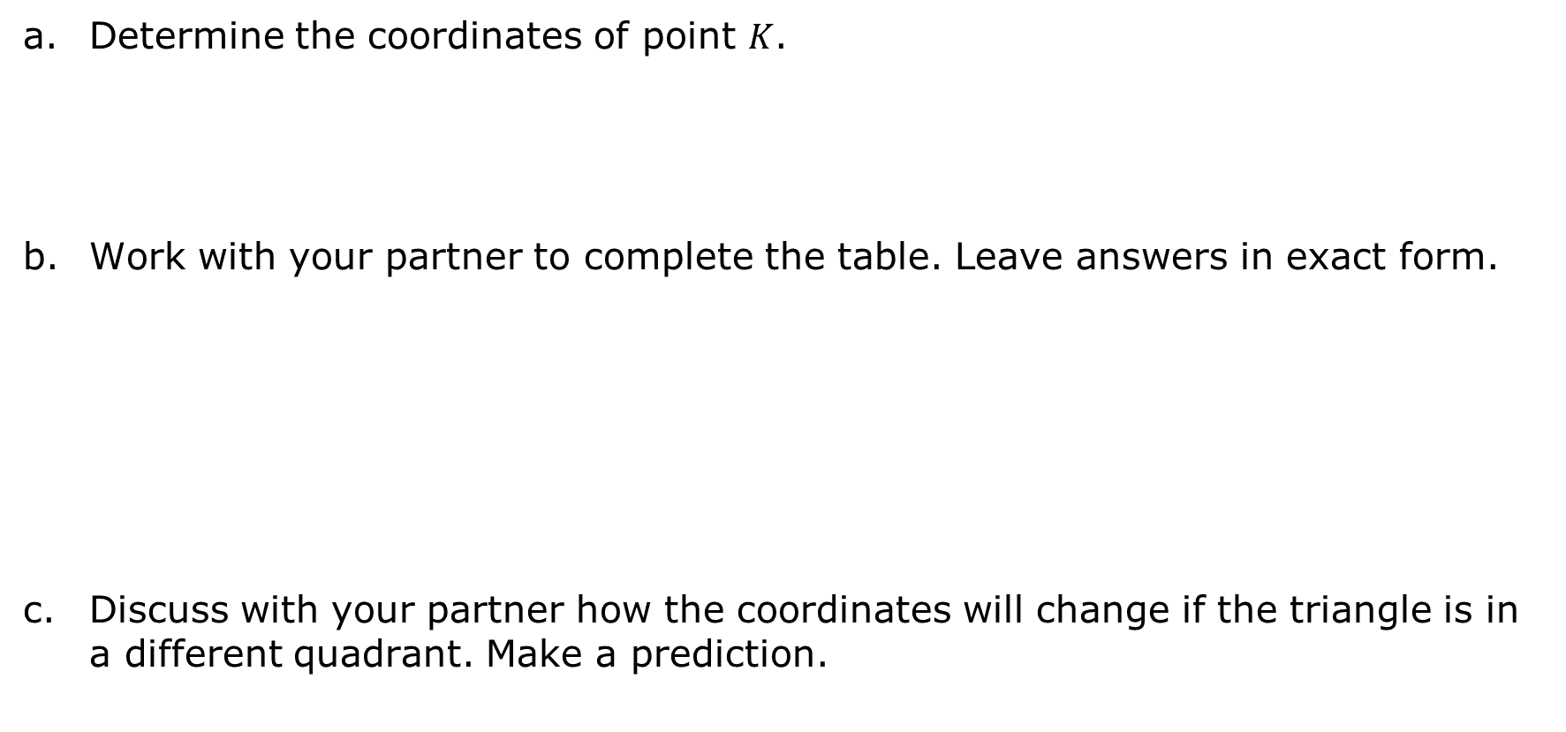
Determine the coordinates of point $K$.
Work with your partner to complete the table. Leave answers in exact form.
Discuss with your partner how the coordinates will change if the triangle is in a different quadrant. Make a prediction.
Angle | Sine | Cosine | Tangent
$$60°$$ ($m∠R)$
volume 1, pg. 411

Slide 17
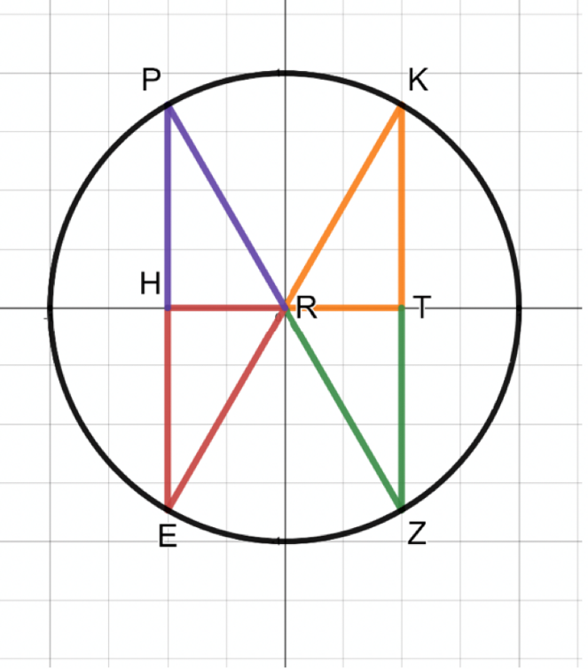
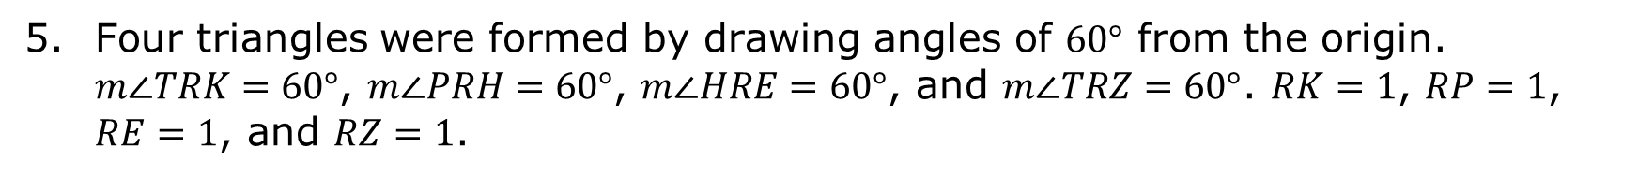
Four triangles were formed by drawing angles of $60°$ from the origin. $m∠TRK=60°$, $m∠PRH=60°$, $m∠HRE=60°$, and $m∠TRZ=60°$. $RK=1$, $RP=1$, $RE=1$, and $RZ=1$.
volume 1, pg. 411

Slide 18
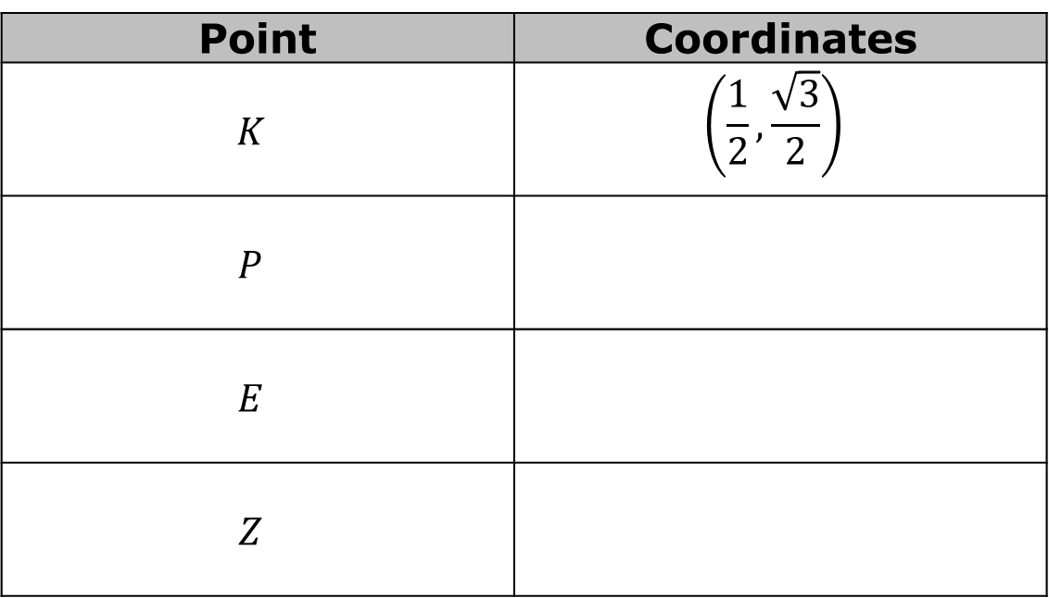
Complete the table.
Point | Coordinates
$$K$$ | $$\left(\frac{1}{2},\frac{\sqrt{3}}{2}\right)$$
$$P$$
$$E$$
$$Z$$
volume 1, pg. 411

Slide 19
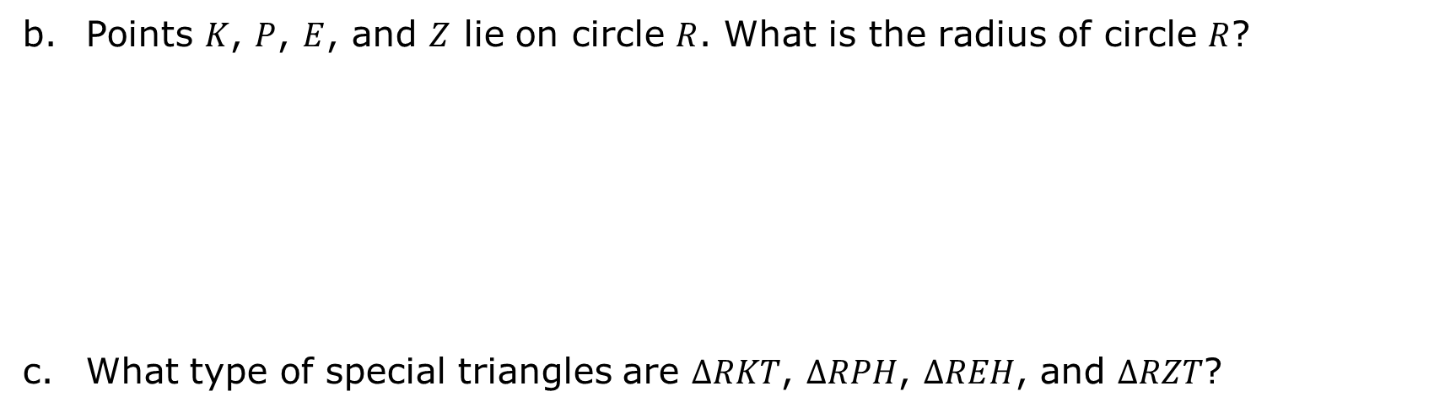
Points $K$, $P$, $E$, and $Z$ lie on circle $R$. What is the radius of circle $R$?
What type of special triangles are $∆RKT$, $∆RPH$, $∆REH$, and $∆RZT$?
volume 1, pg. 412

Slide 20
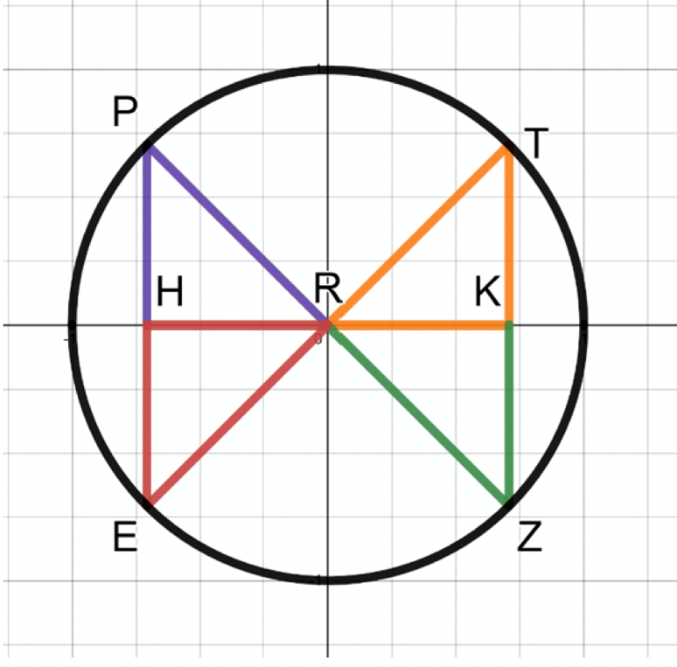
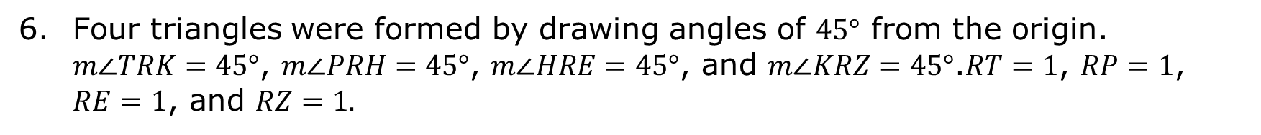
Four triangles were formed by drawing angles of $45°$ from the origin. $m∠TRK=45°$, $m∠PRH=45°$, $m∠HRE=45°$, and $m∠KRZ=45°$.$RT=1$, $RP=1$, $RE=1$, and $RZ=1.$
volume 1, pg. 412

Slide 21


Complete the table.
Points $T$, $P$, $E$, and $Z$ lie on circle $R$. What is the radius of circle $R$?
What type of special triangles are $∆RTK$, $∆RPH$, $∆REH$, and $∆RKZ$?
Point | Coordinates
$$T$$ | $$\left(\frac{\sqrt{2}}{2},\frac{\sqrt{2}}{2}\right)$$
$$P$$
$$E$$
$$Z$$
volume 1, pg. 412

Slide 22
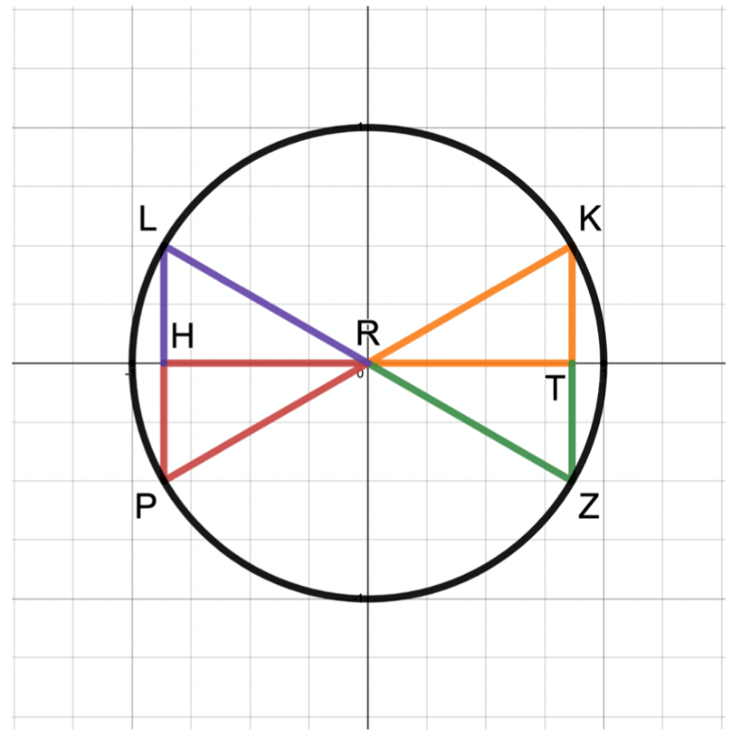
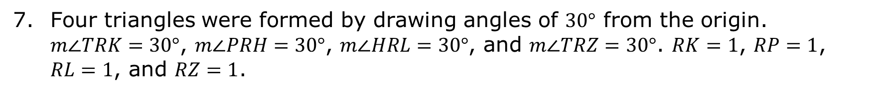
Four triangles were formed by drawing angles of $30°$ from the origin. $m∠TRK=30°$, $m∠PRH=30°$, $m∠HRL=30°$, and $m∠TRZ=30°$. $RK=1$, $RP=1$, $RL=1$, and $RZ=1$.
volume 1, pg. 413

Slide 23
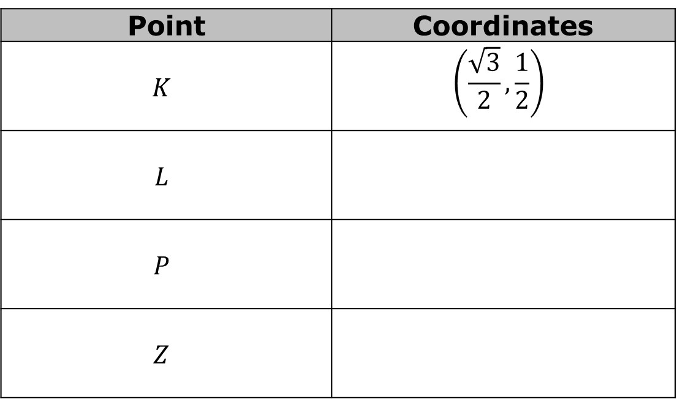
Complete the table.
Point | Coordinates
$$K$$ | $$\left(\frac{\sqrt{3}}{2}, \frac{1}{2}\right)$$
$$L$$
$$P$$
$$Z$$
volume 1, pg. 413

Slide 24
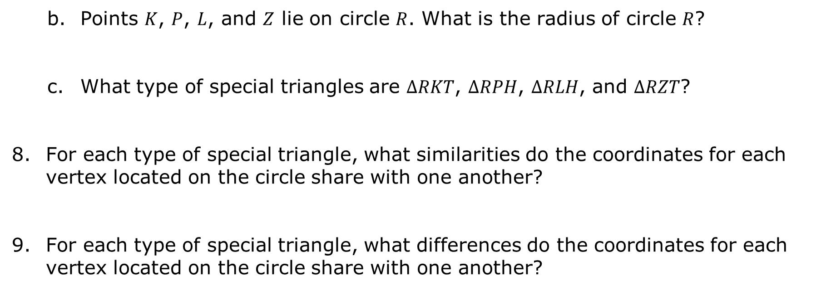
Points $K$, $P$, $L$, and $Z$ lie on circle $R$. What is the radius of circle $R$?
What type of special triangles are $∆RKT$, $∆RPH$, $∆RLH$, and $∆RZT$?
For each type of special triangle, what similarities do the coordinates for each vertex located on the circle share with one another?
For each type of special triangle, what differences do the coordinates for each vertex located on the circle share with one another?
volume 1, pg. 413

Slide 25

Bring It Together
volume 1, pg. 414

Slide 26

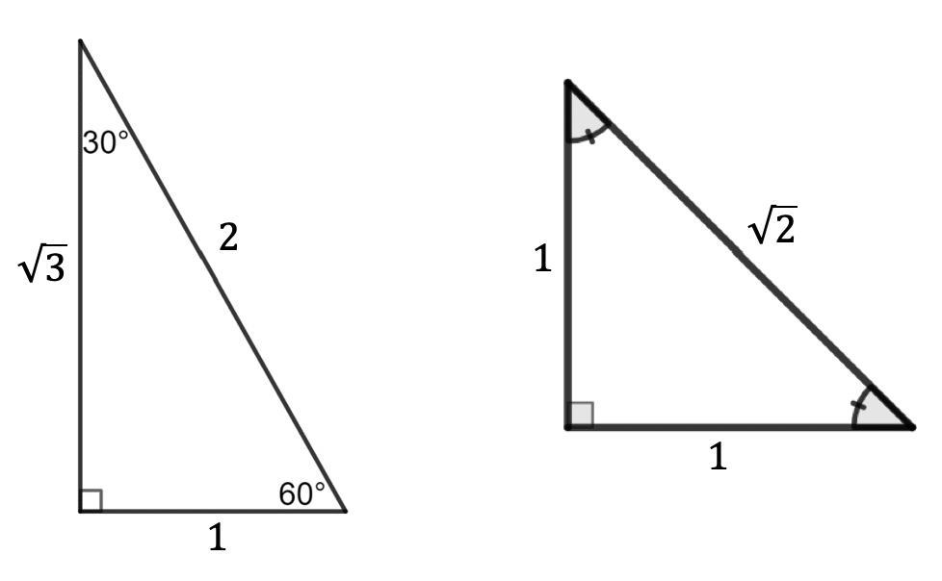
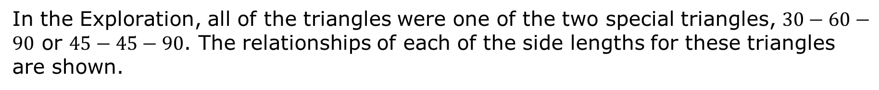
7.7.3 Bring It Together: The Unit Circle
In the Exploration, all of the triangles were one of the two special triangles, $30−60−90$ or $45−45−90$. The relationships of each of the side lengths for these triangles are shown.
volume 1, pg. 414

Slide 27
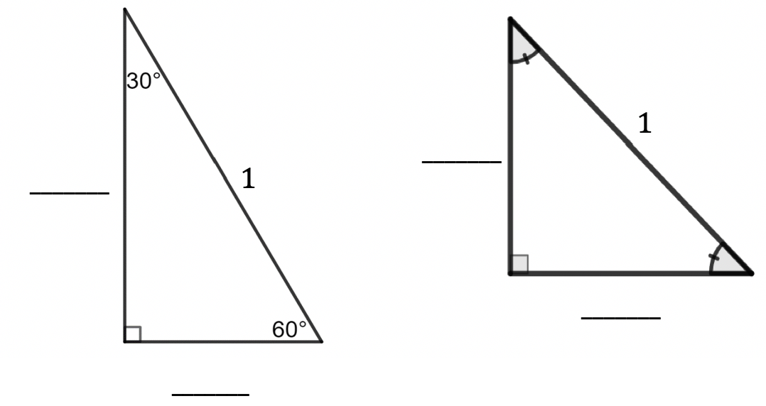
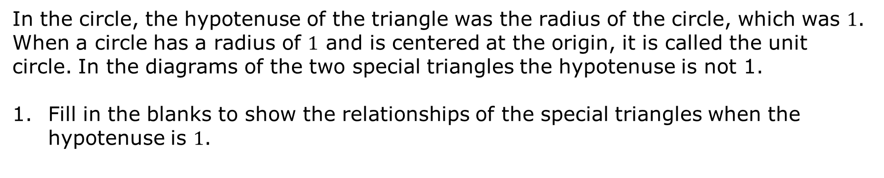
In the circle, the hypotenuse of the triangle was the radius of the circle, which was $1$. When a circle has a radius of $1$ and is centered at the origin, it is called the unit circle. In the diagrams of the two special triangles the hypotenuse is not 1.
Fill in the blanks to show the relationships of the special triangles when the hypotenuse is $1$.
volume 1, pg. 414

Slide 28
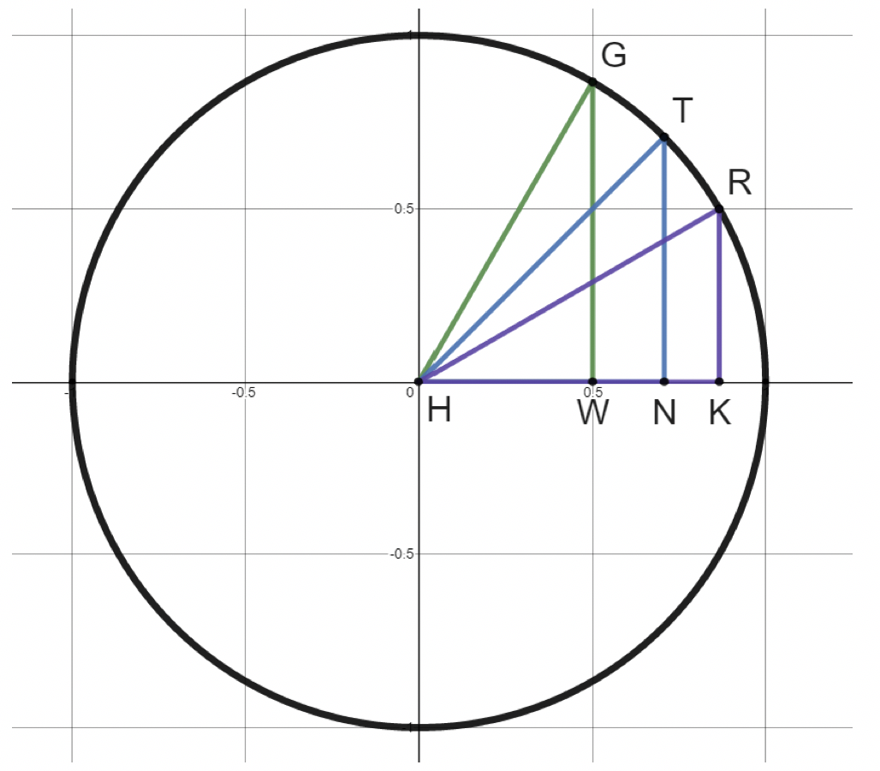
A unit circle with $∆HKR$, $∆HGW$, and $∆HNT$ is shown, where $m∠KHR=30°$, $m∠NHT=45°$, $m∠WHG=60°, m∠GWH=90°$, $m∠HNT=90°$, and $m∠HKR=90°$.
volume 1, pg. 414

Slide 29
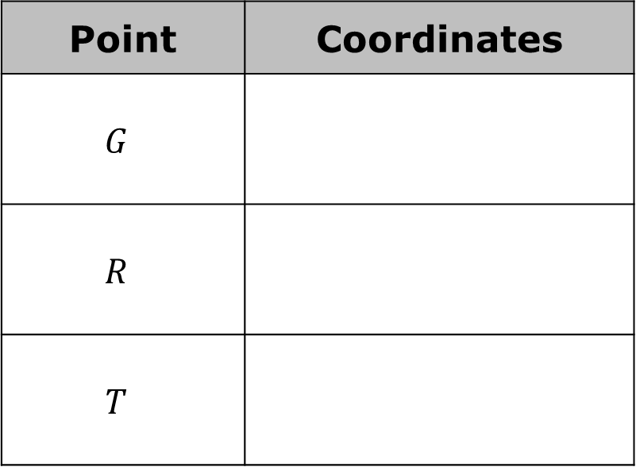
Complete the table.
Point | Coordinates
$$G$$
$$R$$
$$T$$
volume 1, pg. 414

Slide 30

Try It
volume 1, pg. 415

Slide 31

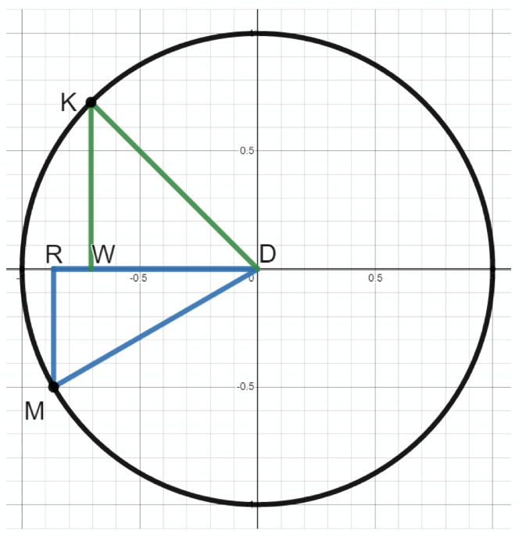
7.7.4 Try It: Finding Coordinates in the Unit Circle
A unit circle is shown where $∆KDW$ and $∆MRD$ are right triangles, $m∠KDW=45°$, and $m∠RDM=30°$.
volume 1, pg. 415

Slide 32

Complete the table.
Point | Coordinates
$$K$$
$$M$$
volume 1, pg. 415

Slide 33

Wrap-Up
volume 1, pg. 415

Slide 34
7.7.5 Wrap-Up: Reflection
Complete the table.
The terms and information used in the Exploration that I knew were … | Something I wondered during the Exploration was … | Something I learned during the Exploration was …
volume 1, pg. 415

